Slide 1
Let’s Rally!
Notes:
Updated 8-18-15, 2015

Slide 2
State budget
$1.8 billion shortfall to maintain current funding

Slide 3
CCC Asks
$8M DeJardin science complex
$8M Community Center
$39.8M Deferred maintenance
$3.2M Safety and security needs

Slide 4
Budget scenarios
More tuition increases – up to $6 per credit
Program reductions or eliminations
Staff and service reductions
Operating cuts to fund deferred maintenance and safety & security needs

Slide 5
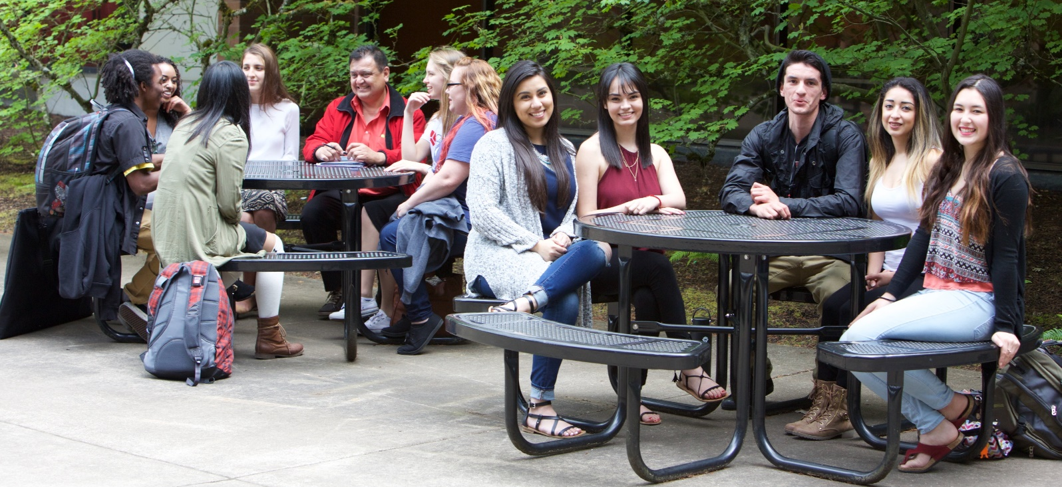
Town Hall
Saturday, Feb. 10
Noon-2 p.m.
PCC, Sylvania campus

Slide 6
Tips
Arrive early and sign up to speak
Wear your CCC gear
Consider taking TriMet
Driving? Park in the “general” spots
Go as a group and do something fun before or after
Get students to join you!

Slide 7
Go Cougars!

